Slide 1


Machine Learning
Presented by Anaya Mughal Bisma Malik Presented to: Maam Faryal

Slide 2
What is Machine Learning?
Machine Learning is a branch of Artificial Intelligence that enables computers to learn patterns from data and make decisions without being explicitly programmed.
What is Explicit Programming? We write exact rules and instructions for the computer.
Example:
If the animal has whiskers and meows, it’s a cat.
if (animal.hasWhiskers && animal.meows) {
return "Cat";
}

Slide 3
How Machine Learning is Different?
Instead of writing rules, we give the computer lots of data (e.g., pictures of cats and dogs).
The computer learns patterns from this data itself.
Then it can decide on its own if a new picture is a cat or dog, without us writing rules.
Data → Machine Learning → Prediction

Slide 4
Types of Machine Learning:
There are four main types of Machine Learning:
Supervised Learning
Unsupervised Learning
Semi-Supervised Learning
Reinforcement Learning

Slide 5
Supervised learning
Supervised learning is a type of machine learning in which the model is trained using labeled data, meaning each input has a correct output (answer) to learn from. Example: Animal Image Recognition: You give a computer many animal pictures with labels:
🐶 Picture → "Dog"
🐱 Picture → "Cat"
🐰 Picture → "Rabbit"
The computer learns from these labeled images.
Later, when you show a new picture without a label, it can predict: “This is a Dog!”

Slide 6
Real-Life Examples of Supervised Learning
Email Spam Filter The email system is trained with many emails labeled as “Spam” or “Not Spam.” The computer learns to recognize spam emails and can filter new incoming emails accordingly.
Face Recognition The computer is given many pictures with people's names as labels. Then it can identify who is in new pictures it has never seen before.
Weather Prediction Old weather data with labels like temperature and humidity is used. The machine learns patterns and predicts future weather.
Handwriting Recognition The computer is trained with many examples of handwritten numbers or letters with correct labels. Then it can read new handwriting and tell the correct number or letter.

Slide 7
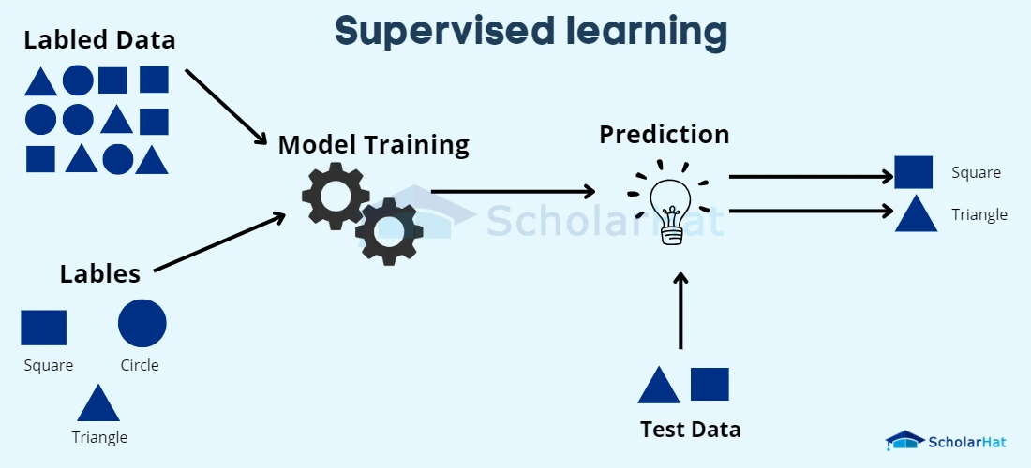
How Supervised Learning Works
Step 1: Collect Labeled Data First, we collect a large set of data where each example has a correct label. Example: Pictures of shapes with names like “square ” or “circle.”
Step 2: Train the Model The computer uses this labeled data to learn patterns and relationships between the input (e.g., shape image) and the output (e.g., shape name).
Step 3: Test the Model After training, we give the computer new, unlabeled data (like a new shape) to see if it can predict the correct label.
Step 4: Make Predictions The model uses what it learned to predict labels for new data it has never seen before.

Slide 8
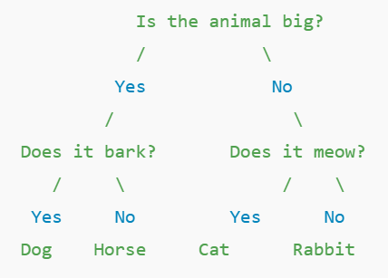
Popular Algorithms in Supervised Learning
1. Linear Regression – For Predictions
Linear regression is used to predict a value based on past data. For example, predicting a student’s marks based on hours studied.
2. Decision Tree – Simple Explanation:
A Decision Tree is a type of algorithm that makes decisions by asking questions step by step, just like how we think logically.
Suppose you want to identify an animal.
Here’s how the Decision Tree will work:
Let’s say the animal is big and it barks → ✅ It’s a Dog.
Let’s say it’s small and it meows → ✅ It’s a Cat.

Slide 9
3.K-Nearest Neighbors (KNN):
KNN is an algorithm that makes decisions based on similarity.
📘 Example: Fruit Liking
Suppose we want to know if Ali likes mangoes.
We look at 3 of his close friends:
🧑‍🤝‍🧑 Friend 1: Likes Mango
👩 Friend 2: Likes Mango
👦 Friend 3: Doesn’t like Mango
Since 2 out of 3 like Mango → KNN guesses: ✅ Ali probably likes Mango too!

Slide 10
Thanks

